Slide 1
The Applications of 3D Printing in Theatre and Entertainment
By: Tyler DiGregorio Aubin
College of Liberal Arts, Theatre Design and Technology 2022

Slide 2

Why Am I doing this Presentation?
My own Interest in 3D printing and Modeling
To explore how this could be applied in theatre
Talk to others about their uses
Find Uses for the UNH THDA Department

Slide 3
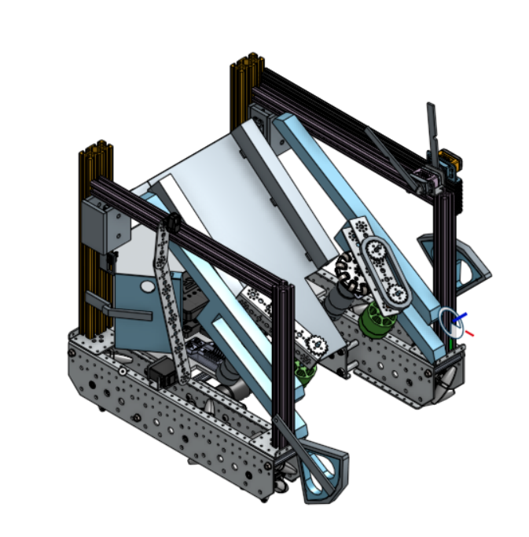
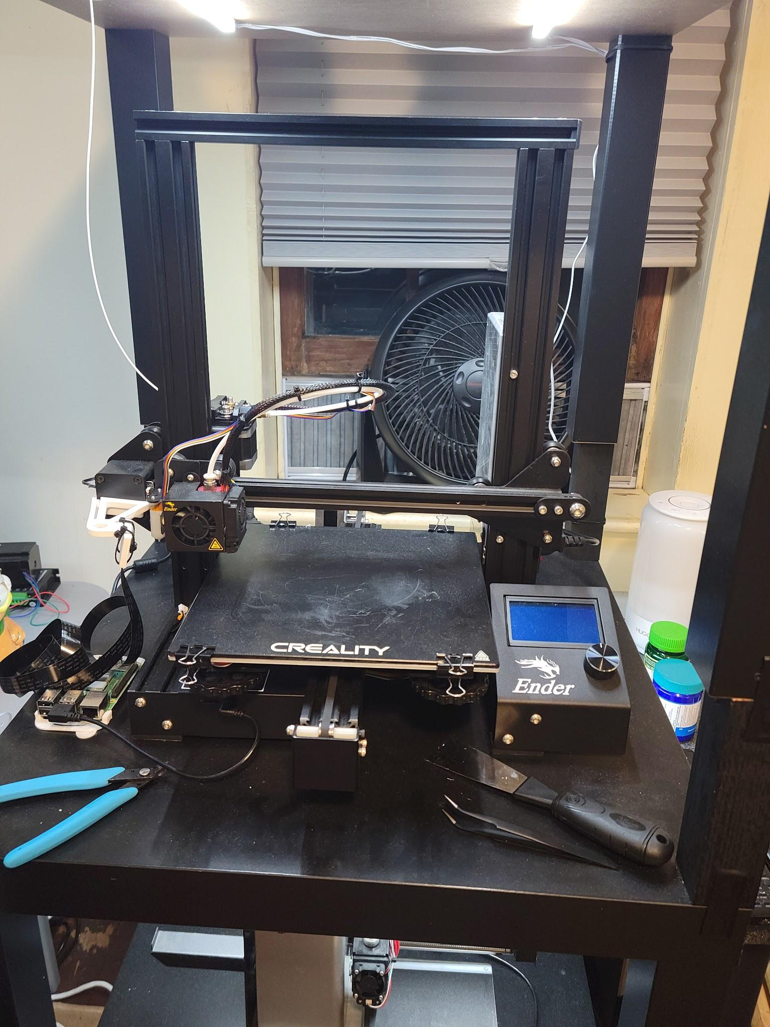
Example of My CAD Modeling
My Current Printer (Ender 3 Pro)

Slide 4
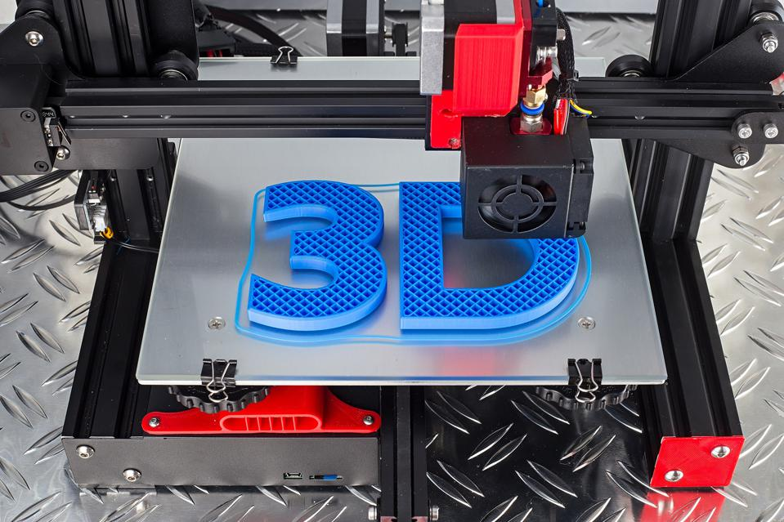
What is 3D Printing?
3D printing is a method of rapid prototyping and construction using different methods of laying and forming plastics and other materials.
It started to take off around 2007 when it started to become more affordable due to patents expiring. Since then the market has exploded
Fused deposition modeling (FDM)
Stereolithography(SLA)
Selective Laser Melting (SLM)

Slide 5
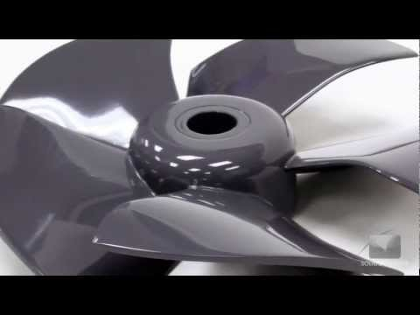
What is FDM

Slide 6
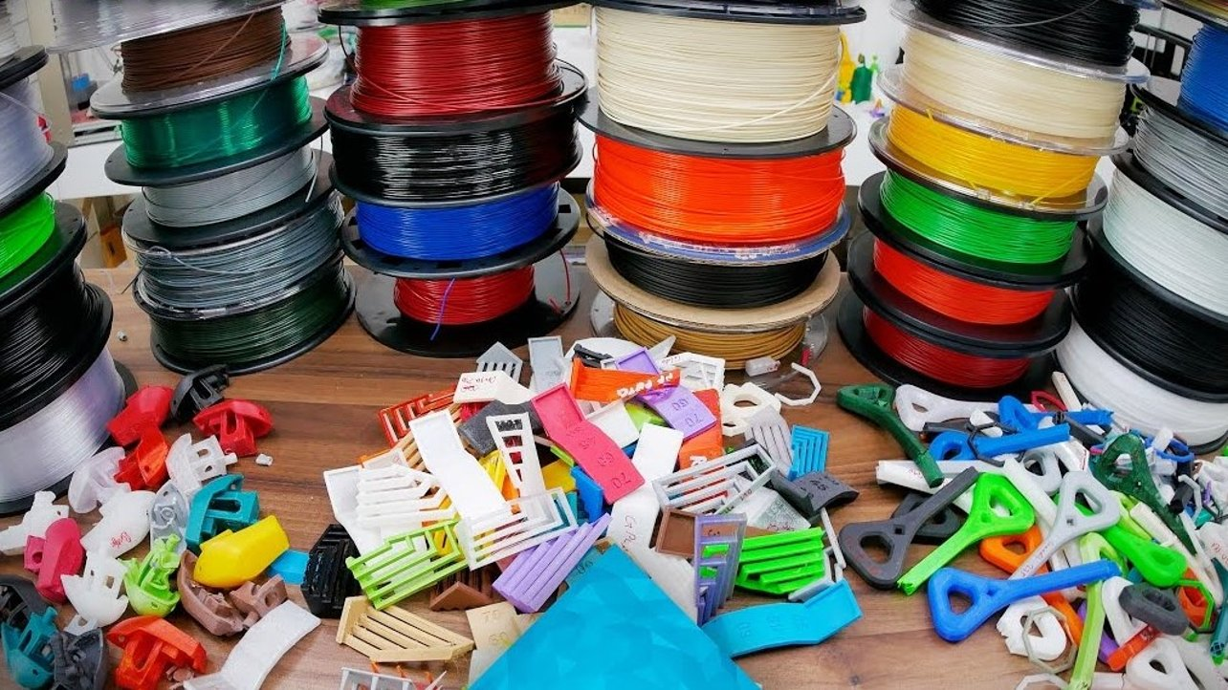
Different Types of 3D printing/ Materials
There are many different methods of 3d printing
What is currently the most accessible: FDM, and SLA
What may become more accessible in the future: SLS (Selective Laser Sintering)

Slide 7
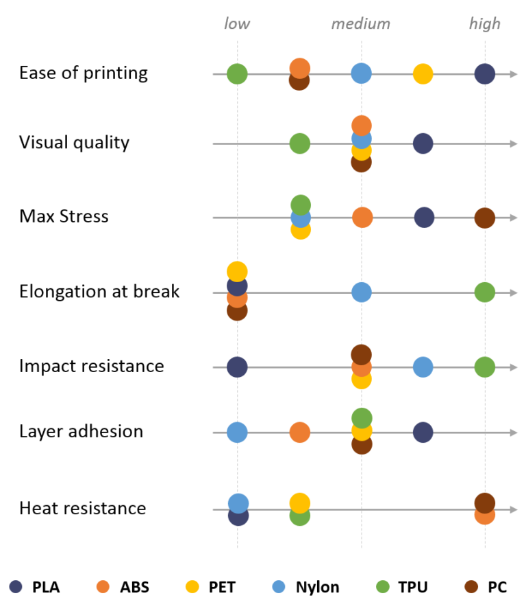
Types of Materials Chart
Source: 3D Hubs

Slide 8
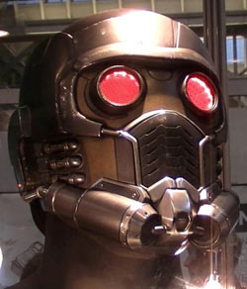
How It Has Already Been Used in Entertainment
Used in many movie props, such as Ironman, Guardians of the Galaxy and many others
In theatre already for small and large props
3D printed Sets
Small Community Theatres

Slide 9
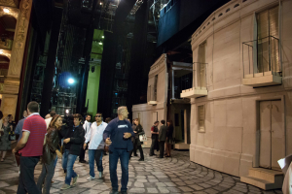
3D Printed Set
Wasp 3D

Slide 10

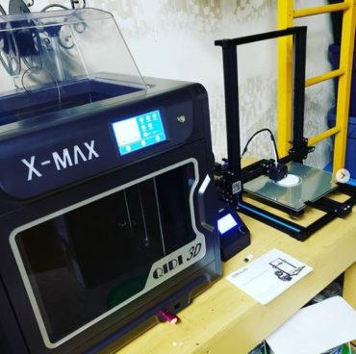
Interview With Chad Sweet From Reno Little Theatre
Small Community Theatre
Saw It as Hiring a Props Artisan
Purchased 2 printers
Qidi X-Max, Creality CR-10s
Cheaper Printer Takes more hand holding
Would Rather purchase another expensive Machine vs Cheaper one

Slide 11

Time Vs Cost
Less Expensive Printers can produce great prints
The work they require
Features More Expensive Printers offer
Reliability
Repair
Upgrades
How this affects theatre

Slide 12
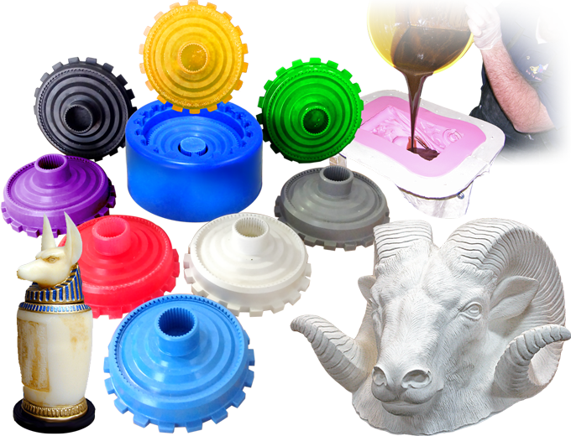
Resin Casting and 3D Printing
Resin Casting is nothing new to Theatre
It has been used extensively
Why it should be used with FDM 3d printing
Reliability
Time
Cost?

Slide 13
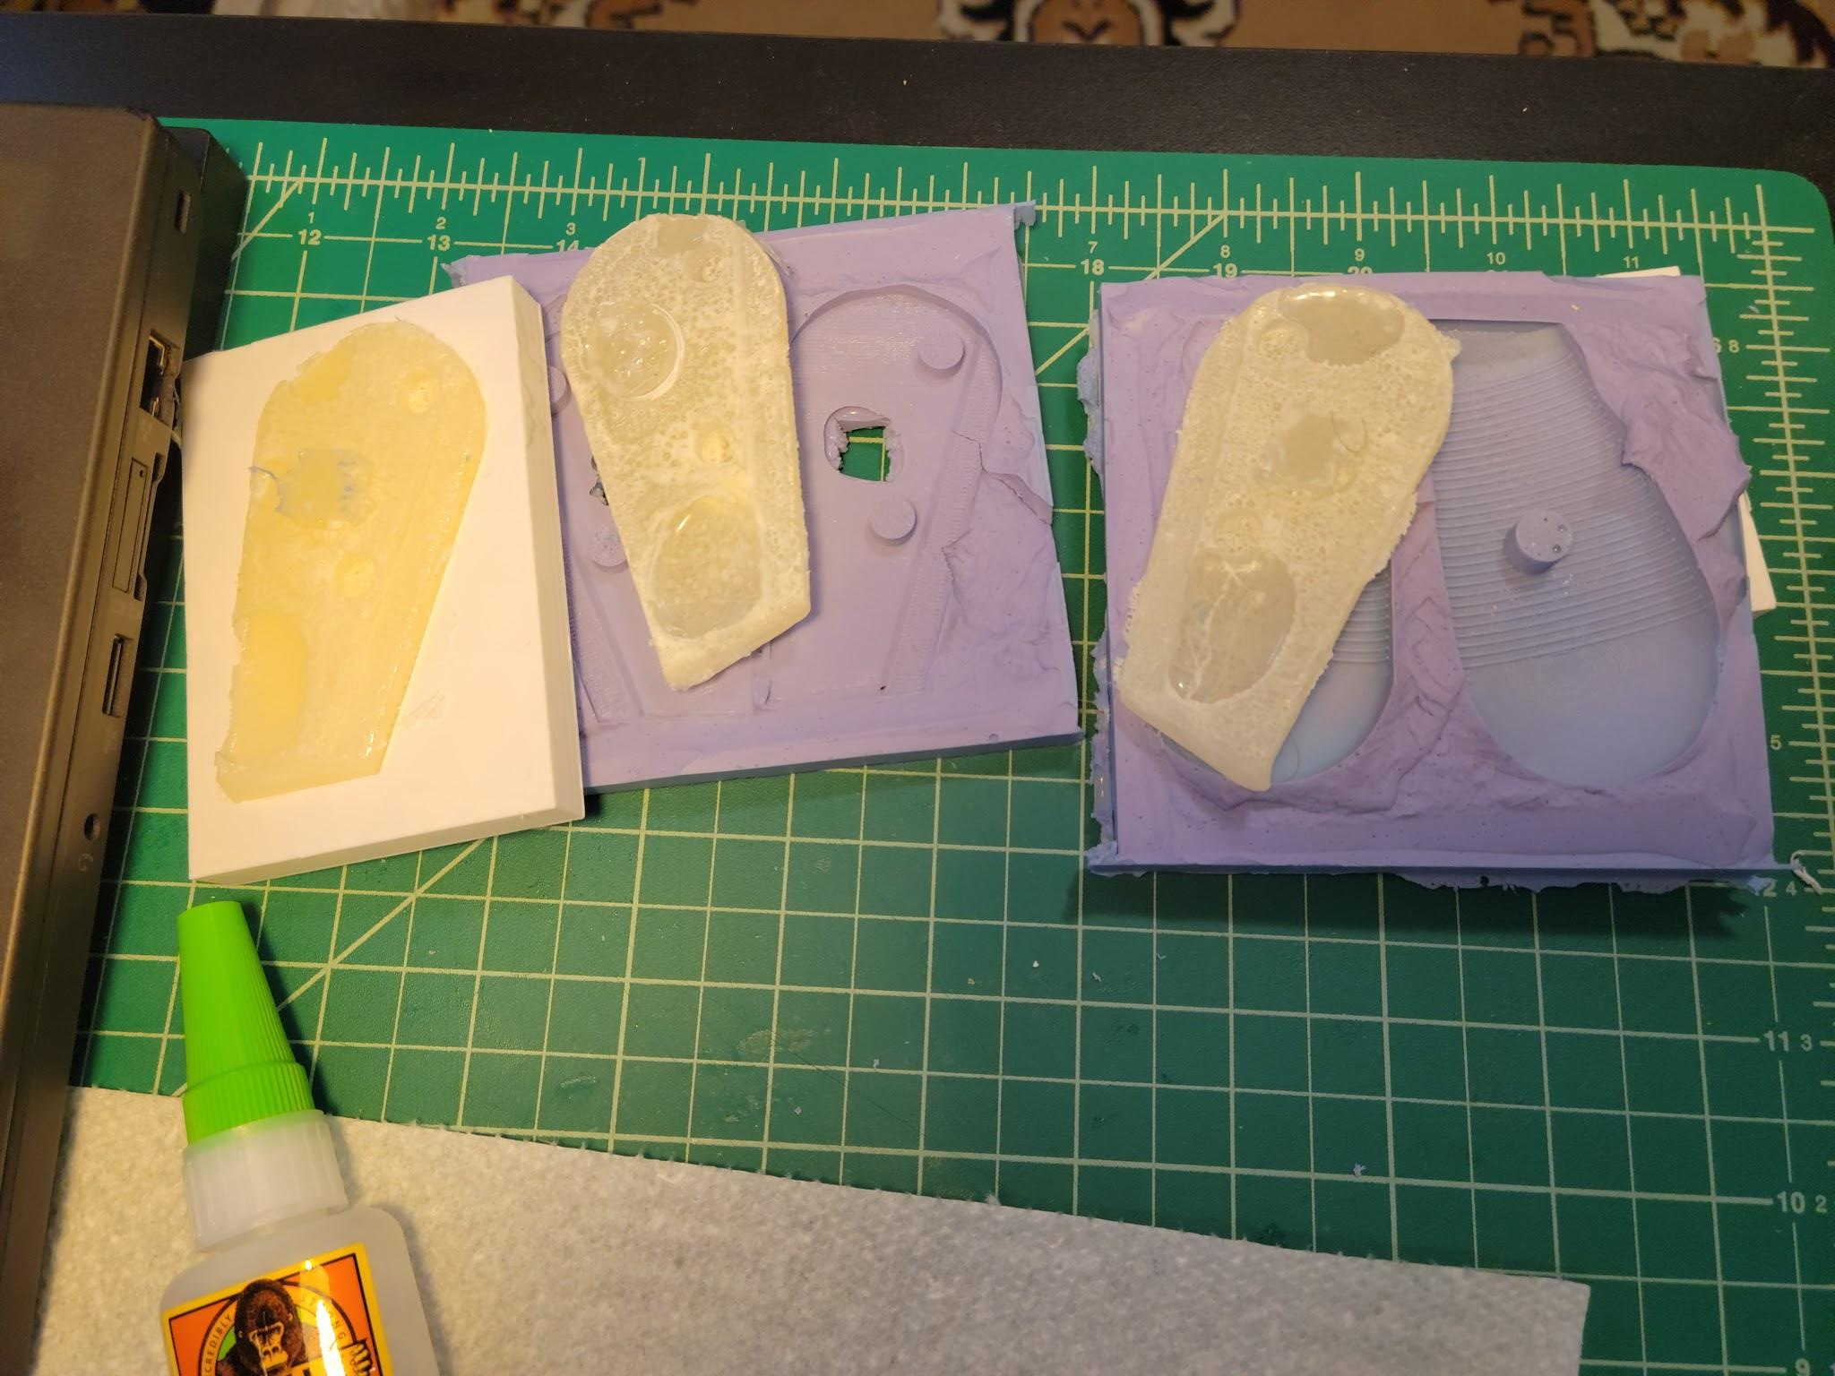
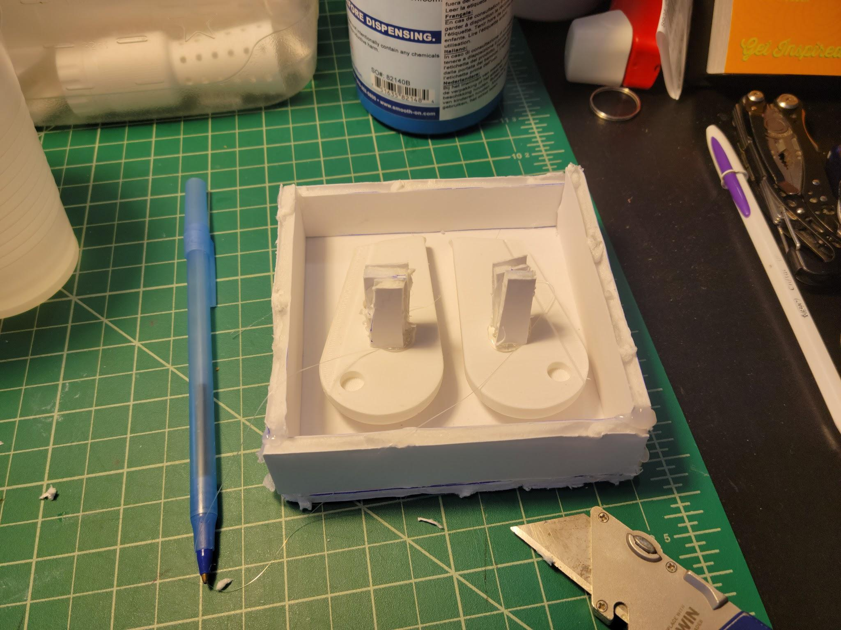
Resin Casting

Slide 14
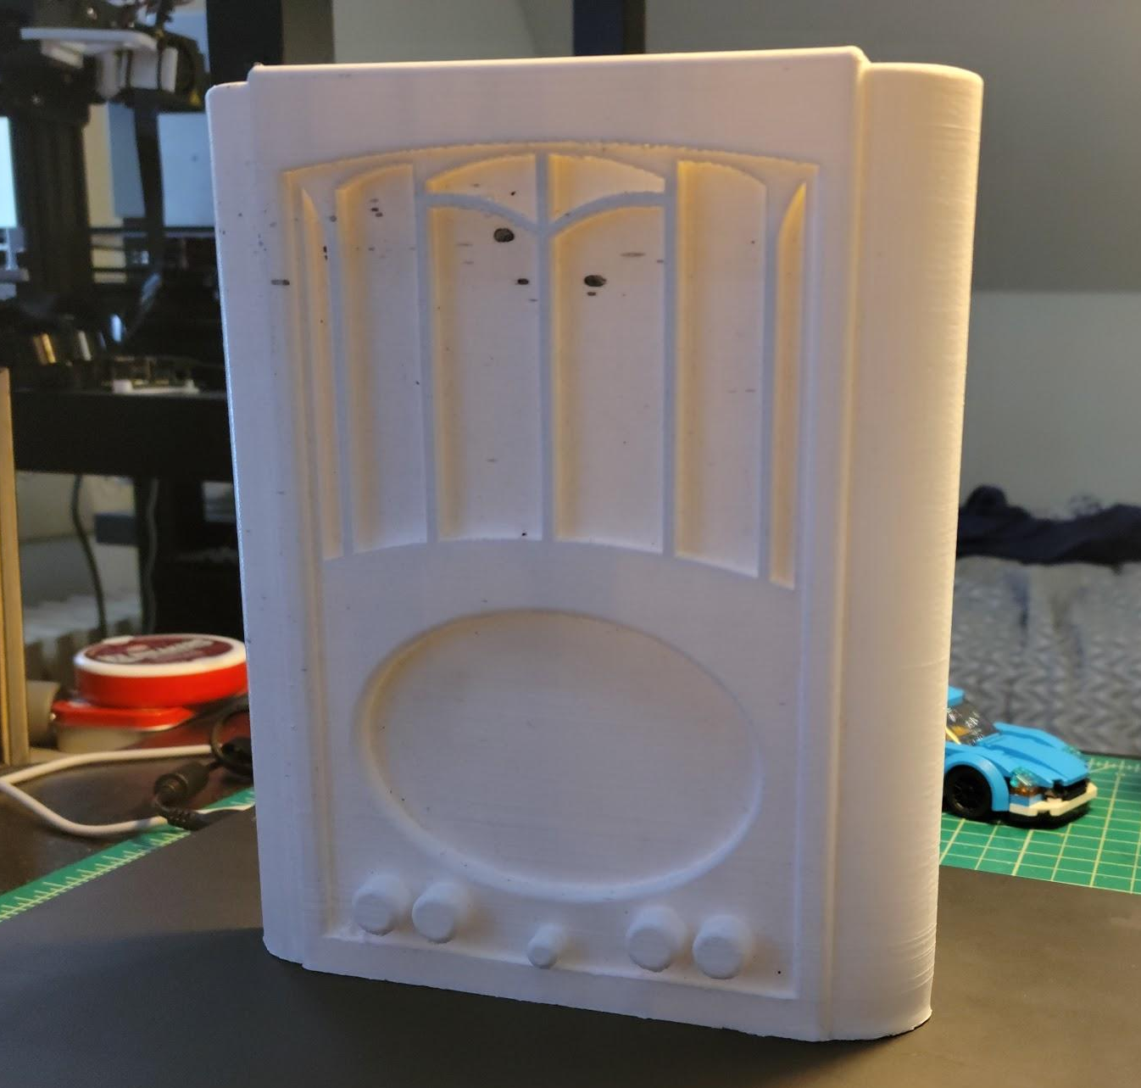
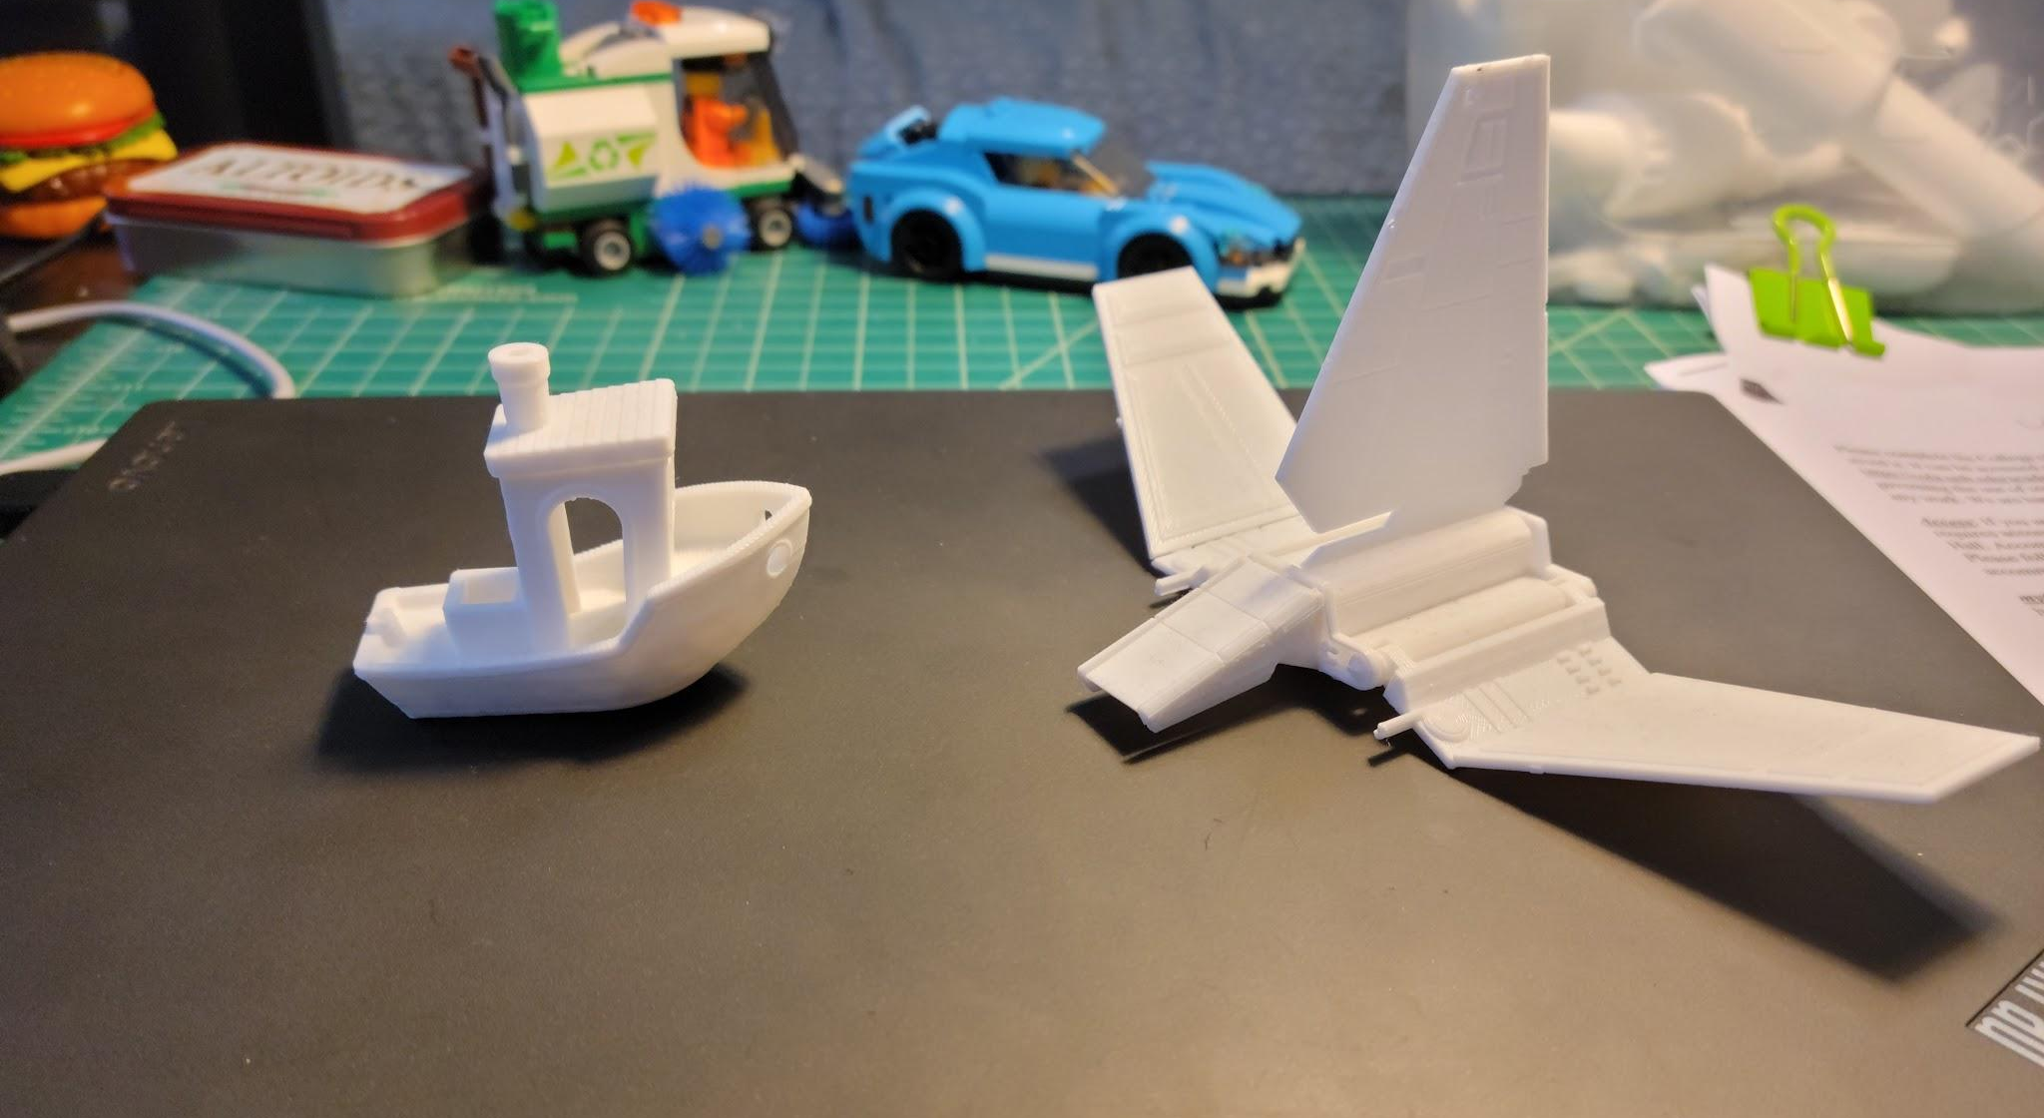
Examples of 3D Prints From My Printer

Slide 15
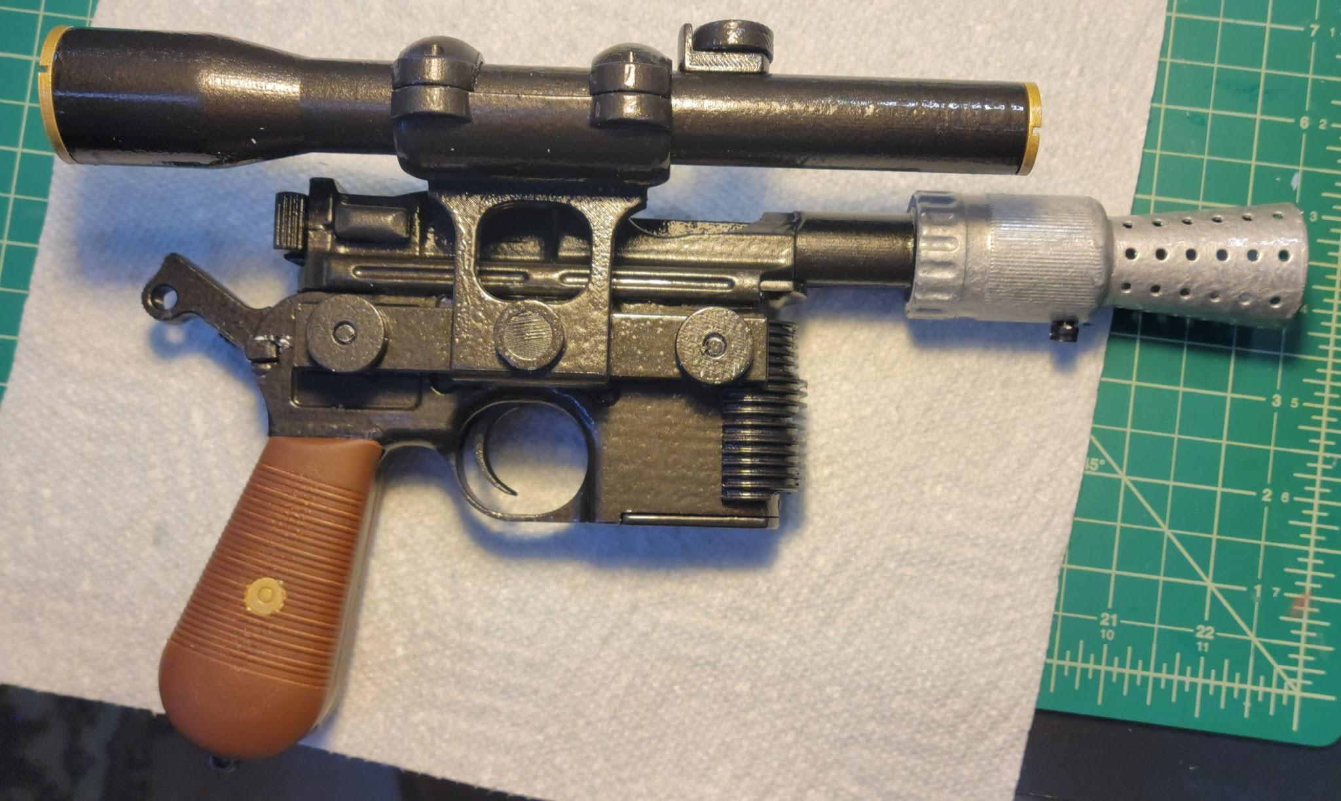
Han Solo Blaster

Slide 16

How this Could be Applied at THE UNH THDA Department
A mid range reliable printer would be beneficial
Costume pieces
Costume high quality detailed props
Set pieces that have been 3d printed
The pros and cons of Hobby Printers

Slide 17
Thank You!

